Slide 1
IoT Based Garage Door Opener
Interfacing Thingspeak with Beaglebone Black
Submitted By:
Dawinder Kaur
C0765505
Submitted To:
Prof. Mike Aleshams

Slide 2
Content:
Introduction
Block Diagram
Required tools
About Tools
Circuit Diagram
About thingspeak
Signing up for Thingspeak
Protocol Used
Coding ESP32 and Beaglebone Black
Conclusion
Reference

Slide 3
Task Objective:
The main objective of this task is to send data from beaglebone black to cloud services such as AWS or Thingspeak.
ESP32 is used to complete this task
In this task ThingSpeak collect information about Garage Door.
It will contain information about how many time door open and when door is been access by person.

Slide 4
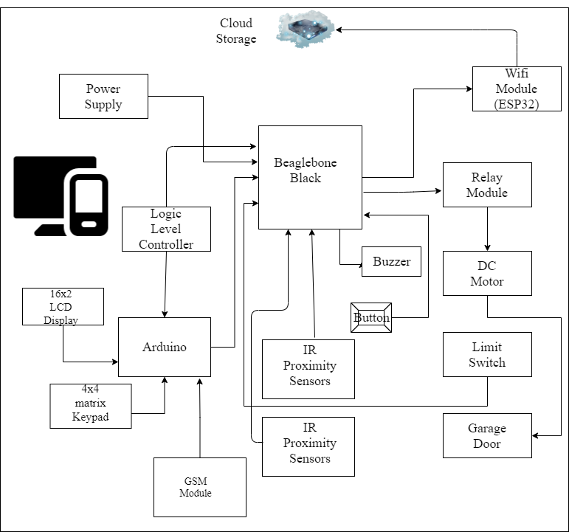
Block Diagram:

Slide 5
Requirements:
Hardware Requirement:
Beaglebone Black
ESP32
DC Motor
Motor driver
USB cable
Jumper cables
Battery
Software Requirement:
Putty
Latest Debian Image
Nano Editor
GCC compiler
Arduino IDE
ThingSpeak

Slide 6
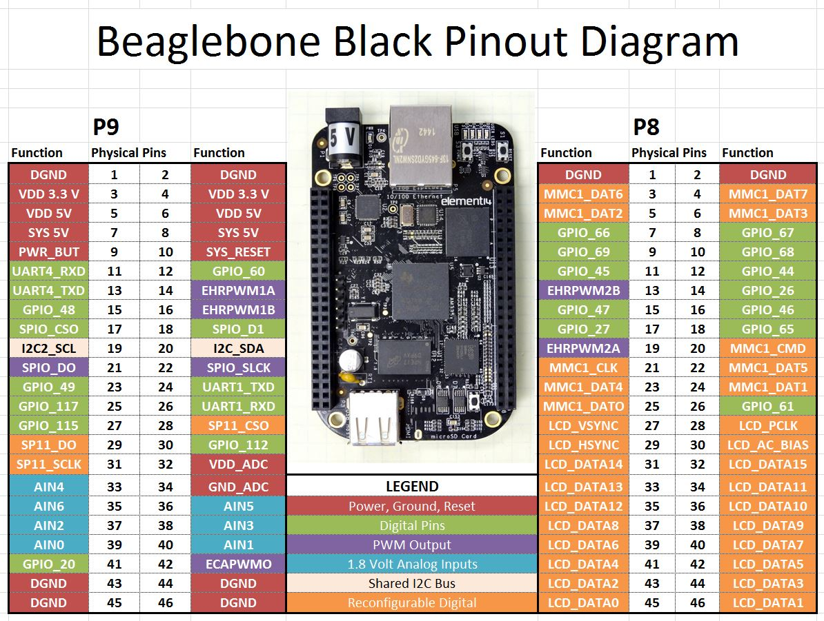
Beaglebone Black:

Slide 7
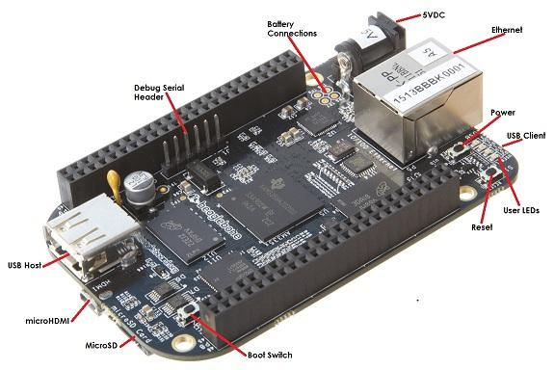
ESP32:
Pin Diagram:
Door Open Pin 14
Door Close Pin 11
Door Status Pin 10
Motor Left Pin 18
Motor Right Pin 17
Ground
5 V

Slide 8
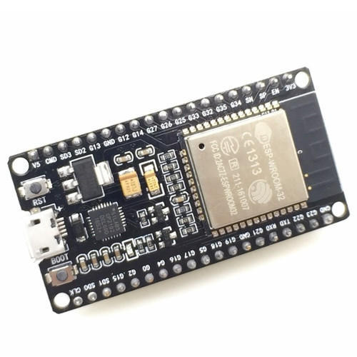
ESP32:
ESP32 is a series of low-cost, low-power system on a chip microcontrollers with integrated Wi-Fi and dual-mode Bluetooth.
ESP32 is created and developed by Espressif Systems, a Shanghai-based Chinese company, and is manufactured by TSMC using their 40 nm process.
It is a successor to the ESP8266 microcontroller.

Slide 9
ESP32:
In this project, we use cloud service to indicate the opening of door- How many time door open, when it is open to make our project more secure.
As beaglebone black does not have inbuilt Wi-Fi module. So, WiFi module ESP32 is used as a WiFi module for IoT connectivity.
GPIO communication is used between two microcontroller.
ESP32 supports wireless IEEE 802.11 standard.

Slide 10
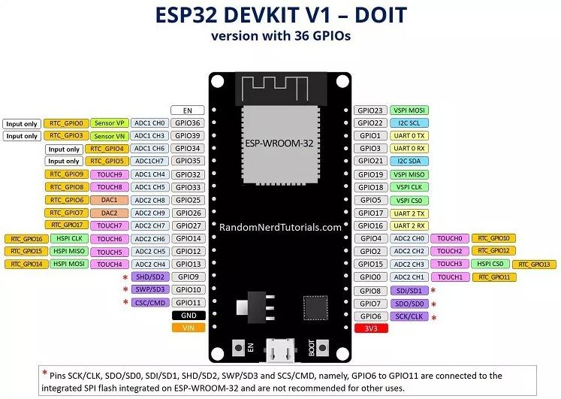
ESP32:
Pin Diagram:
Door Open Pin 14
Door Close Pin 27
Door Status Pin 13
Operating voltage 3.3V

Slide 11
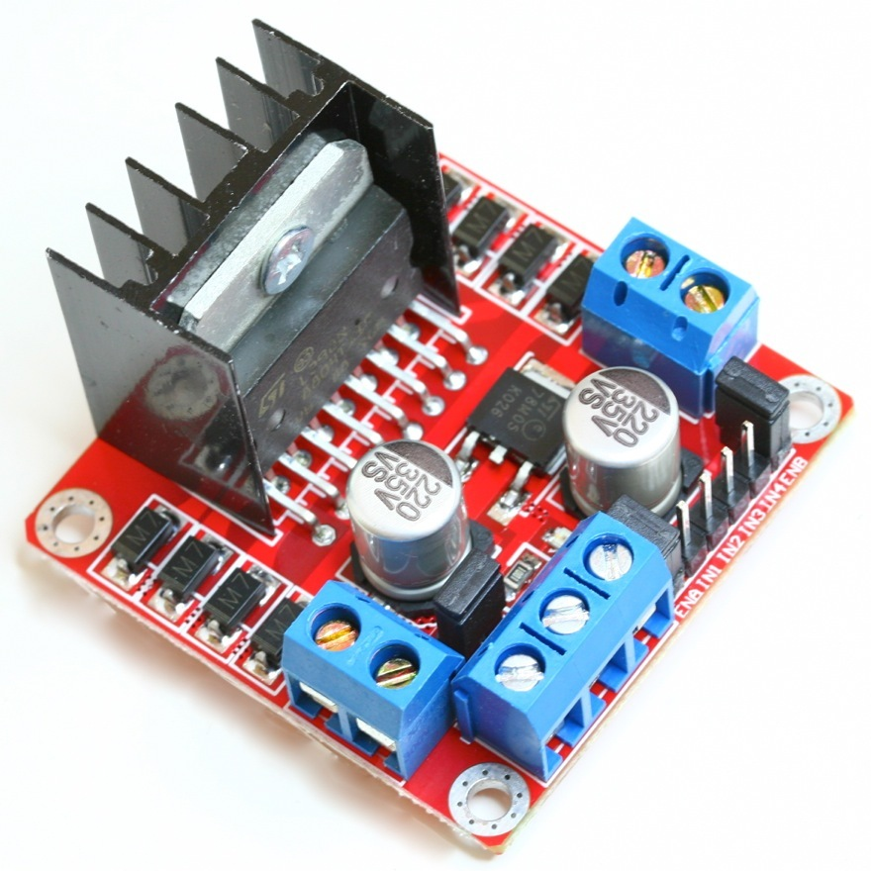
Motor Driver:
Motor drivers are circuits used to run a motor.
They are current amplifiers used to increase the magnitude of current by a fixed multiple.
Commonly used for motor interfacing
Takes a low current signal and amplifies it to a high magnitude signal.

Slide 12
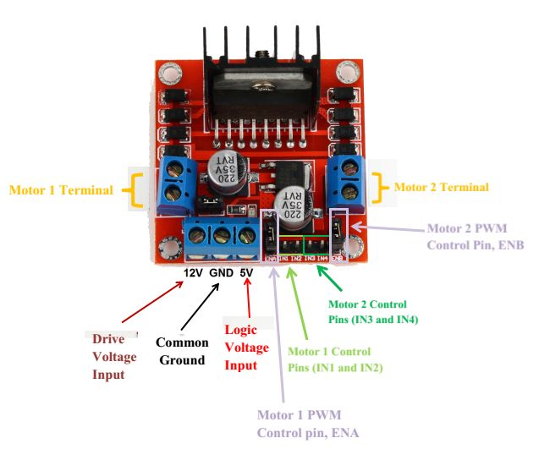
Motor Driver:
Motor Driver 12V -> Battery +
Motor Driver GND -> Battery –
Motor Driver GND -> Beaglebone DGND
Motor Driver Input 1 -> Beaglebone P8.17
Motor Driver Input 2 -> Beaglebone P8.18
Motor Wire 1 -> Motor A +
Motor Wire 2 -> Motor B +

Slide 13
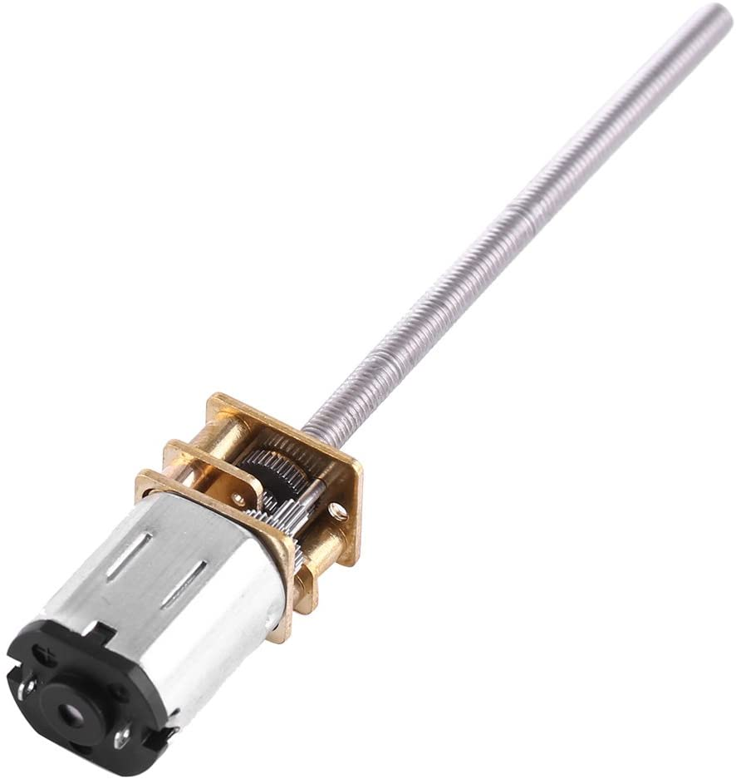
DC Gear Motor:
DC gearmotor has an integrated M3*55mm threaded rod as its output shaft.
Has series of gears, which in turn creates more torque.
Driver Voltage: 5-35V and Driver Current:2A.
Maximum Motor supply current: 2A
Maximum Power (W): 25W
RPM- 150 RPM

Slide 14
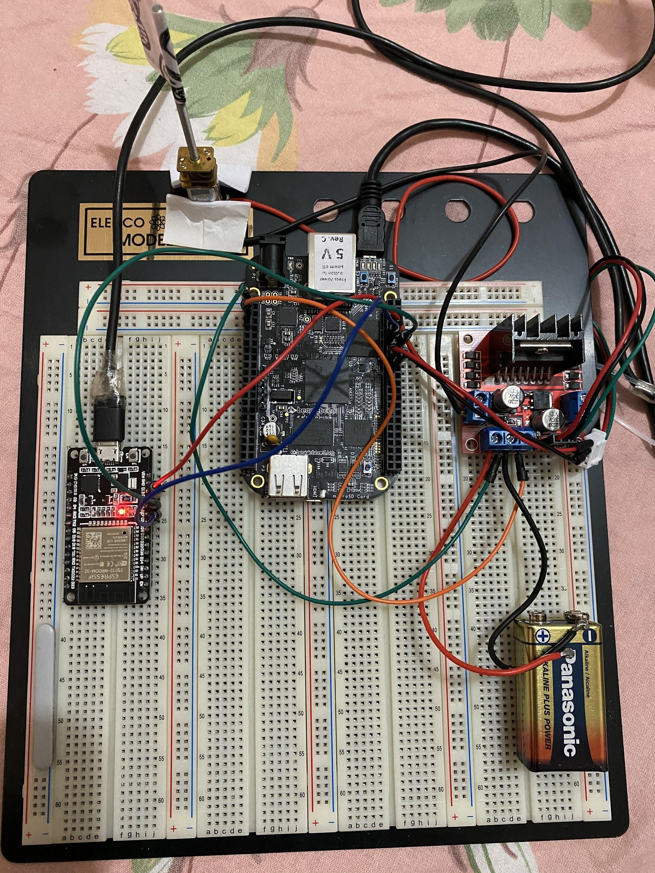
Circuit Diagram:

Slide 15
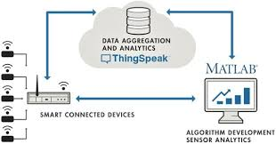
Introduction to ThingSpeak:
ThingSpeak is an open-source Internet of things (IoT) application and API.
It uses the HTTP and MQTT protocol to store and retrieve data over the internet or via a Local Area Network (LAN).
It can generate instant live data visualizations and send notifications using web services.

Slide 16
Introduction to ThingSpeak:
ThingSpeak allows users to aggregate, visualize, and analyze live data streams in the cloud.
It has integrated support of MATLAB from MathWorks.
User can send:
Data to ThingSpeak from their devices
Create instant visualization of live data
Send alerts.

Slide 17
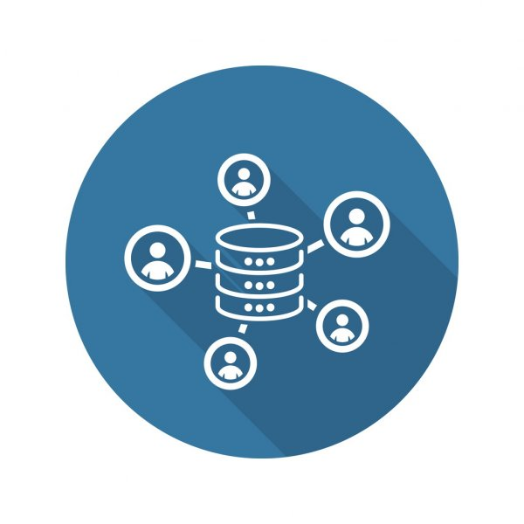

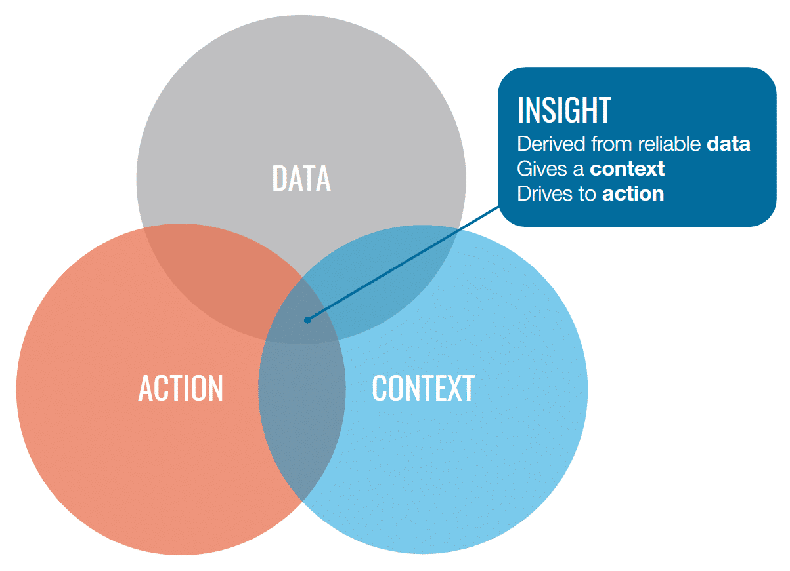
Introduction to ThingSpeak:
Send sensor data privately to the cloud
Analyze and visualize your data with MATLAB.
Trigger a reaction

Slide 18
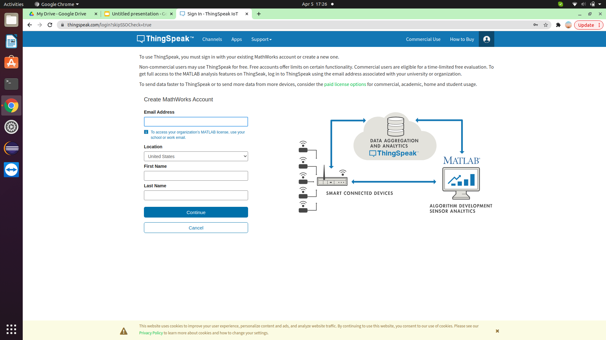
Setting up ThingSpeak:
Create a ThingSpeak account by clicking on profile icon and then register with mail id,location and name.

Slide 19
Setting up ThingSpeak:
Creating a ThingSpeak channel: The core element of ThingSpeak is a ‘ThingSpeak Channel’.
A channel stores the data that we send to ThingSpeak and comprises of the below elements:
8 fields for storing data of any type - These can be used to store the data from a sensor or from an embedded device.
3 location fields - Can be used to store the latitude, longitude and the elevation. These are very useful for tracking a moving device.
1 status field - A short message to describe the data stored in the channel.

Slide 20
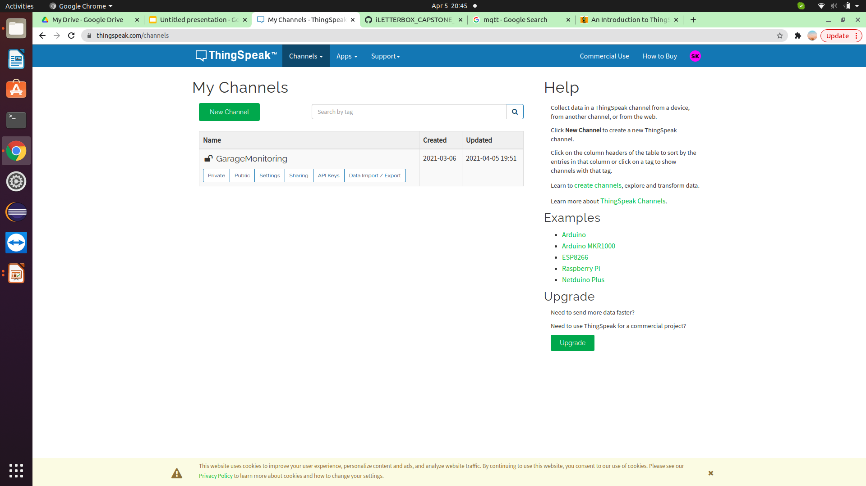
Setting up ThingSpeak:
Creating a ThingSpeak channel:

Slide 21
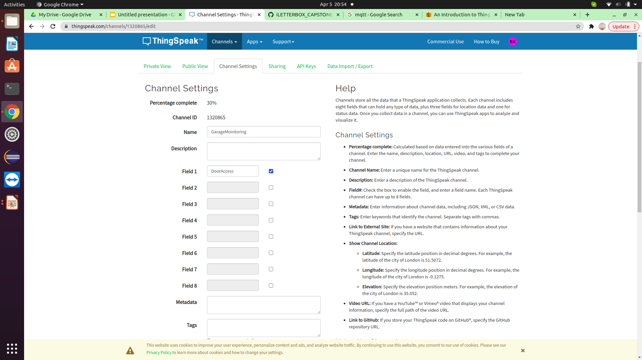
Setting up ThingSpeak:

Slide 22
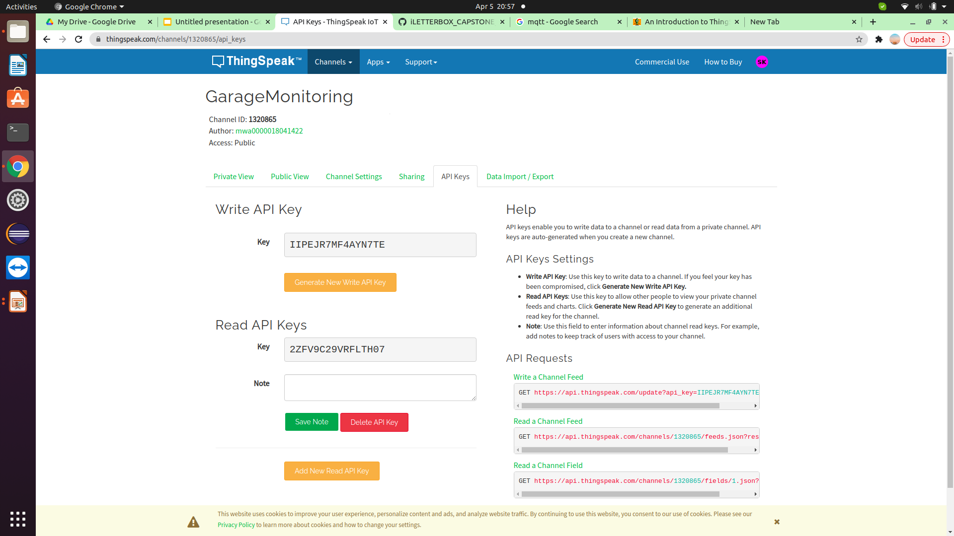
Setting up ThingSpeak:
Setting Channel Read and Write API

Slide 23
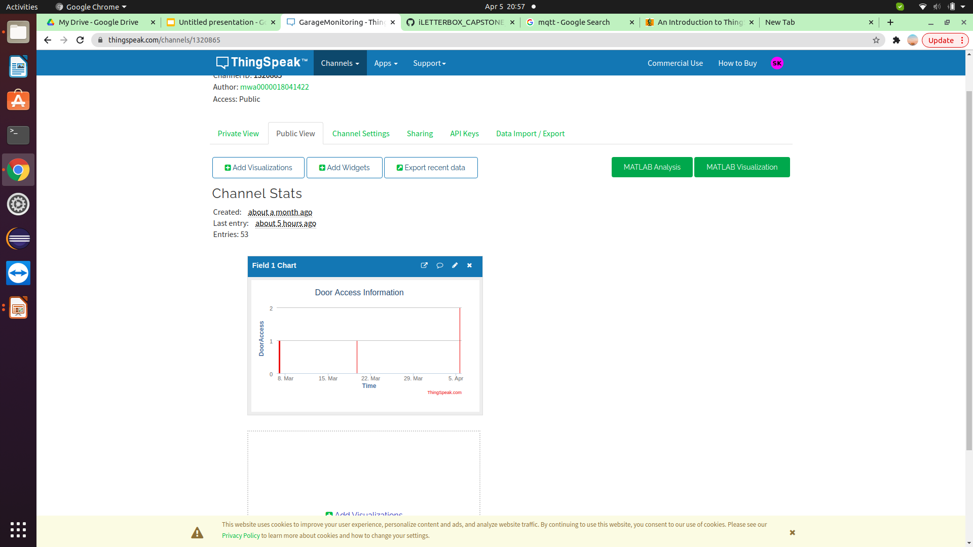
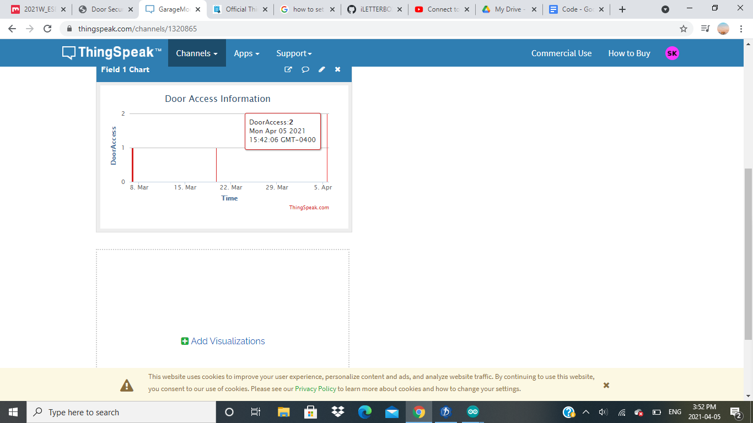
Setting up ThingSpeak:
Setting Field chart entries

Slide 24
Setting up ThingSpeak:
Creating a ThingSpeak channel: The core element of ThingSpeak is a ‘ThingSpeak Channel’.
A channel stores the data that we send to ThingSpeak and comprises of the below elements:
8 fields for storing data of any type - These can be used to store the data from a sensor or from an embedded device.
3 location fields - Can be used to store the latitude, longitude and the elevation. These are very useful for tracking a moving device.
1 status field - A short message to describe the data stored in the channel.

Slide 25
Setting up ThingSpeak:
For cloud connection we use the ESP32 WiFi communication (802.11) , establishing connection with webpage - HTTP and collecting data from sensor -MQTT

Slide 26
WiFi (802.11):
802.11 and 802.11x refers to a family of specifications developed by the IEEE for wireless LAN (WLAN) technology.
802.11 specifies an over-the-air interface between a wireless client and a base station or between two wireless clients.
The IEEE accepted the specification in 1997.
WiFi setup is done by giving SSID and Password of Home router to ESP32 through arduino ide.

Slide 27
HTTP:
HTTP is a protocol which allows the fetching of resources, such as HTML documents.
It is the foundation of any data exchange on the Web and it is a client-server protocol, which means requests are initiated by the recipient, usually the Web browser. It generally use TCP connection to communicate with servers.
Default port number for connection of HTTP is 80 and 443 for secure communication.
Used HTTP protocol in ESP32 code to get HTML page through internet connection.

Slide 28
MQTT:
MQTT is an OASIS standard messaging protocol for the Internet of Things (IoT).
It is designed as an extremely lightweight publish/subscribe messaging transport that is ideal for connecting remote devices with a small code footprint and minimal network bandwidth.
It is a publish-subscriber based messaging protocol. It works on the top of TCP/IP protocol.

Slide 29
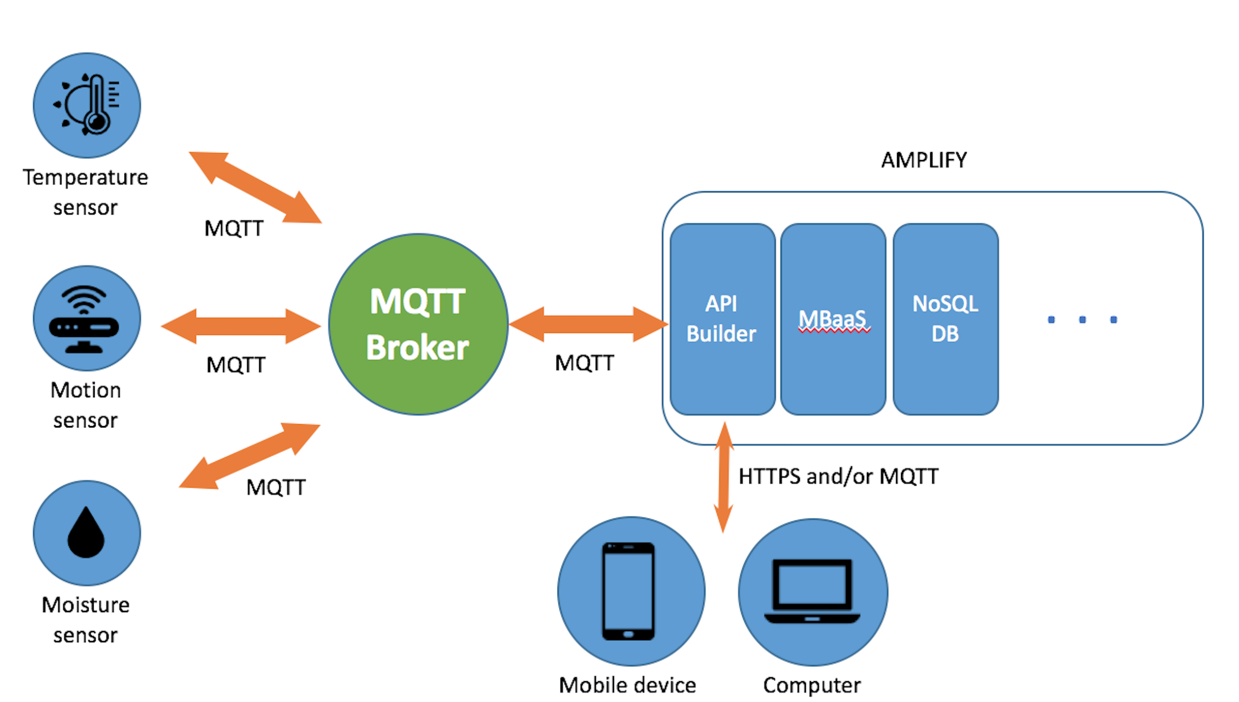
MQTT:

Slide 30
MQTT:
Subscriber: one which receives messages
Publisher: one which publish messages
Server/Broker: the one receives the messages published by the publisher first, even before the subscriber
Client: A client publish a message and receive another message at the same time. It can be publisher or subscriber.
Topic: An UTF-8 string used by the clients and servers to send and receive messages.

Slide 31
MQTT vs HTTP:
MQTT
Message Queuing Telemetry Transport
It works on publish/subscribe model.
Less complex
Used TCP and more data centric
Works on 1883 port
Provides data security with SSL/TLS
HTTP
Hypertext Transfer Protocol
Works on request/response model
More complex
Runs over UDP and more document centric.
Work on port 80 and 8080
Does not provide security but extension HTTPs does provide security on port 43

Slide 32
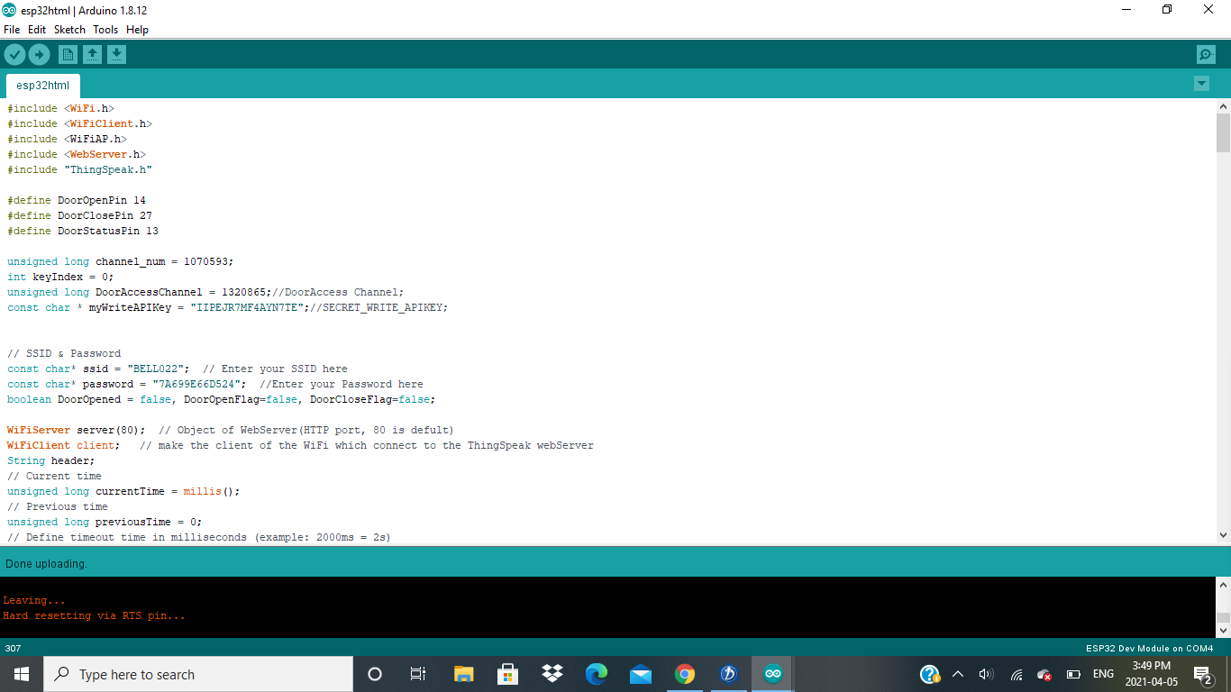
Program: Arduino IDE - ESP32

Slide 33
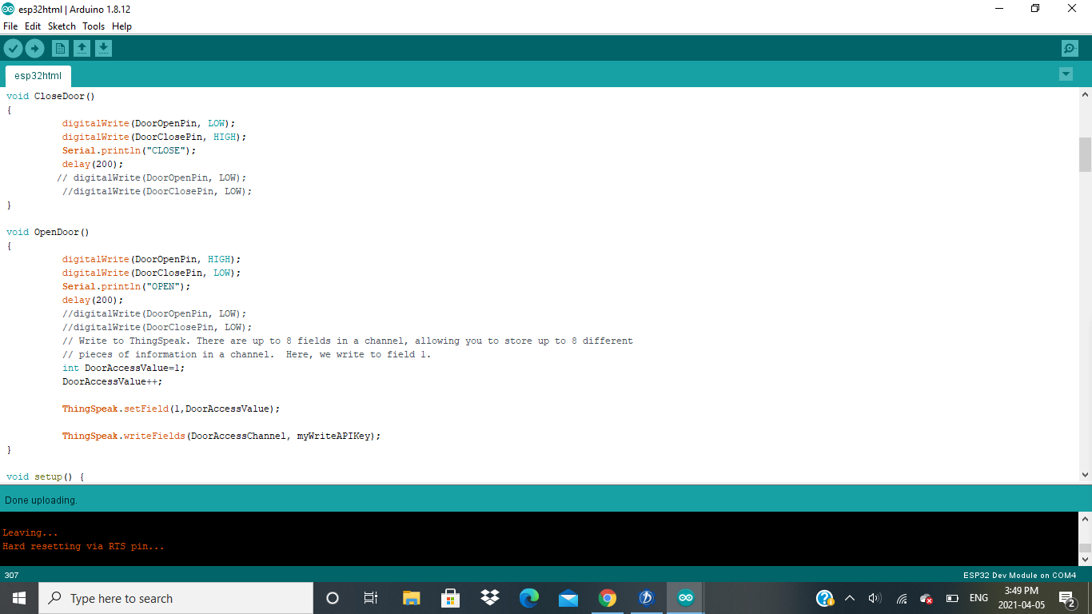
Program: Arduino IDE - ESP32

Slide 34
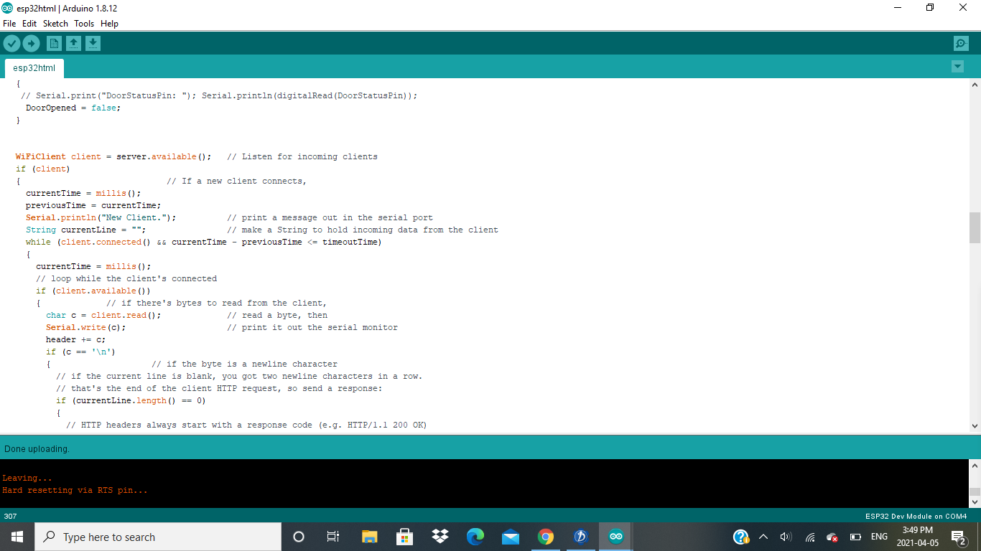
Program: Arduino IDE - ESP32

Slide 35
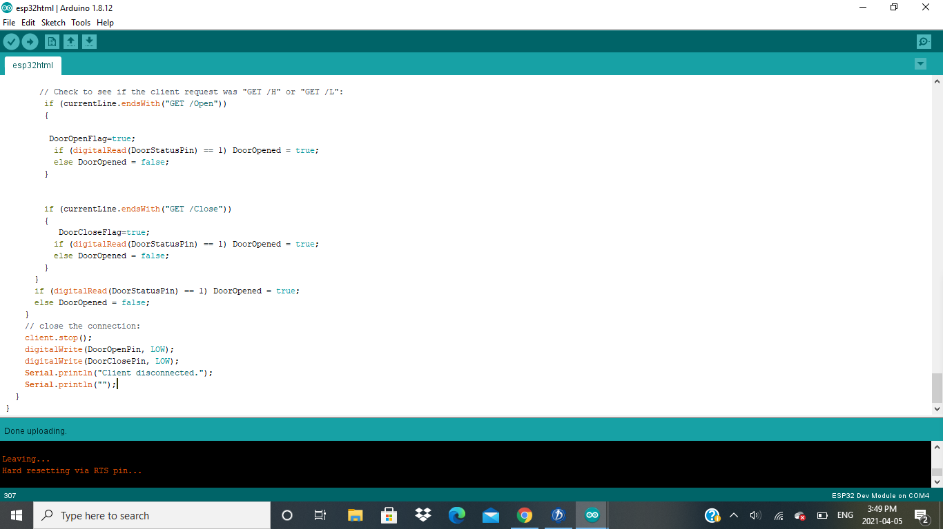
Program: Arduino IDE - ESP32

Slide 36
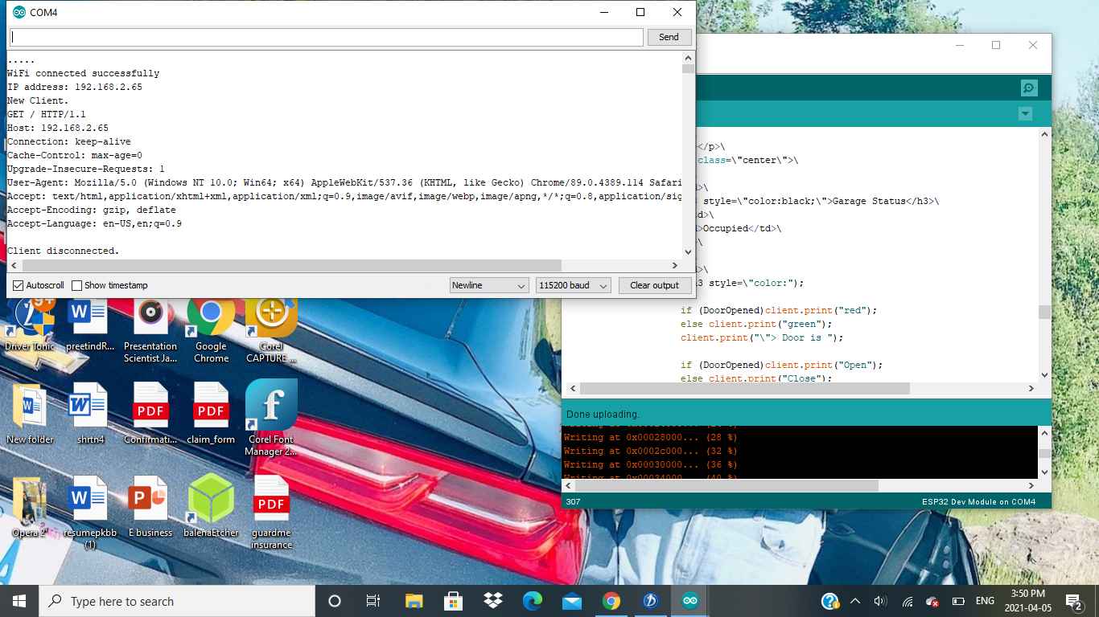
Output: ESP32

Slide 37
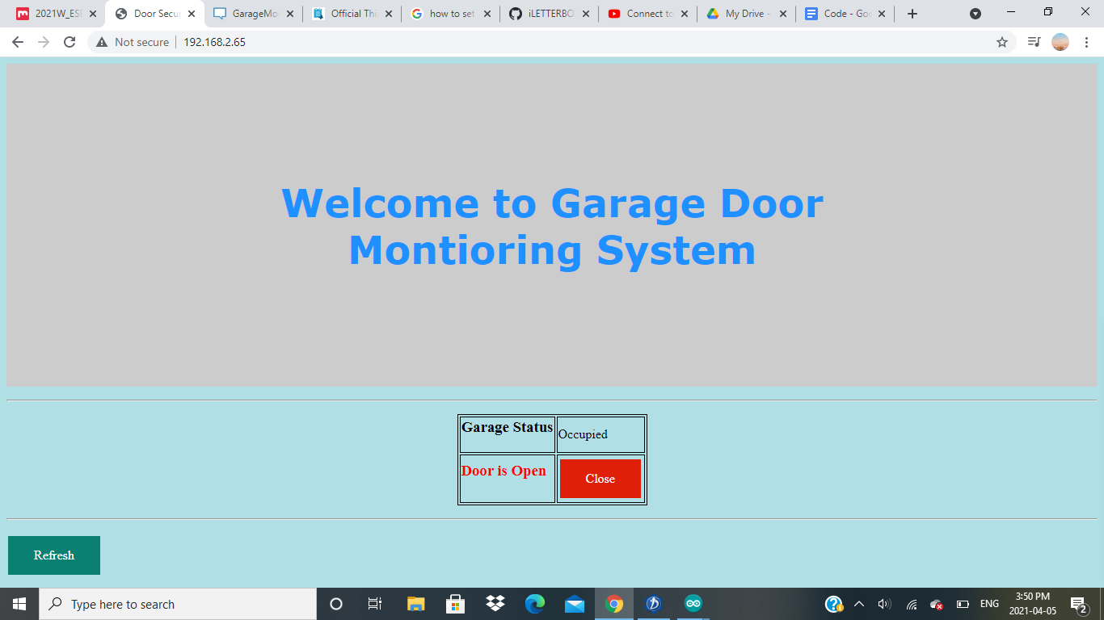
Output: ESP32

Slide 38
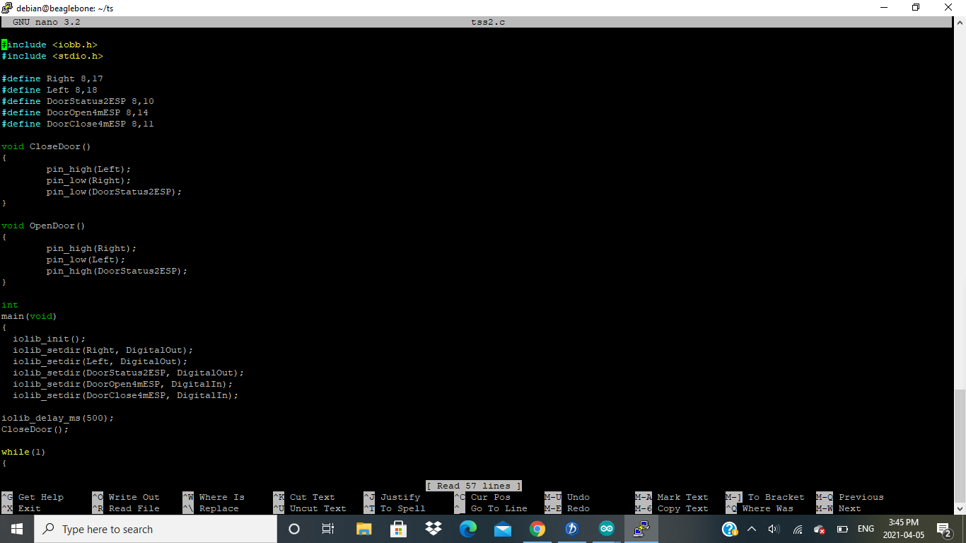
Program: Nano editor - BBB

Slide 39
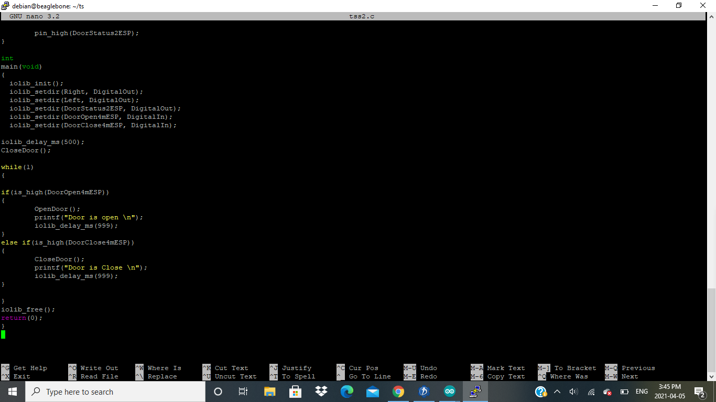
Program: Nano editor - BBB

Slide 40
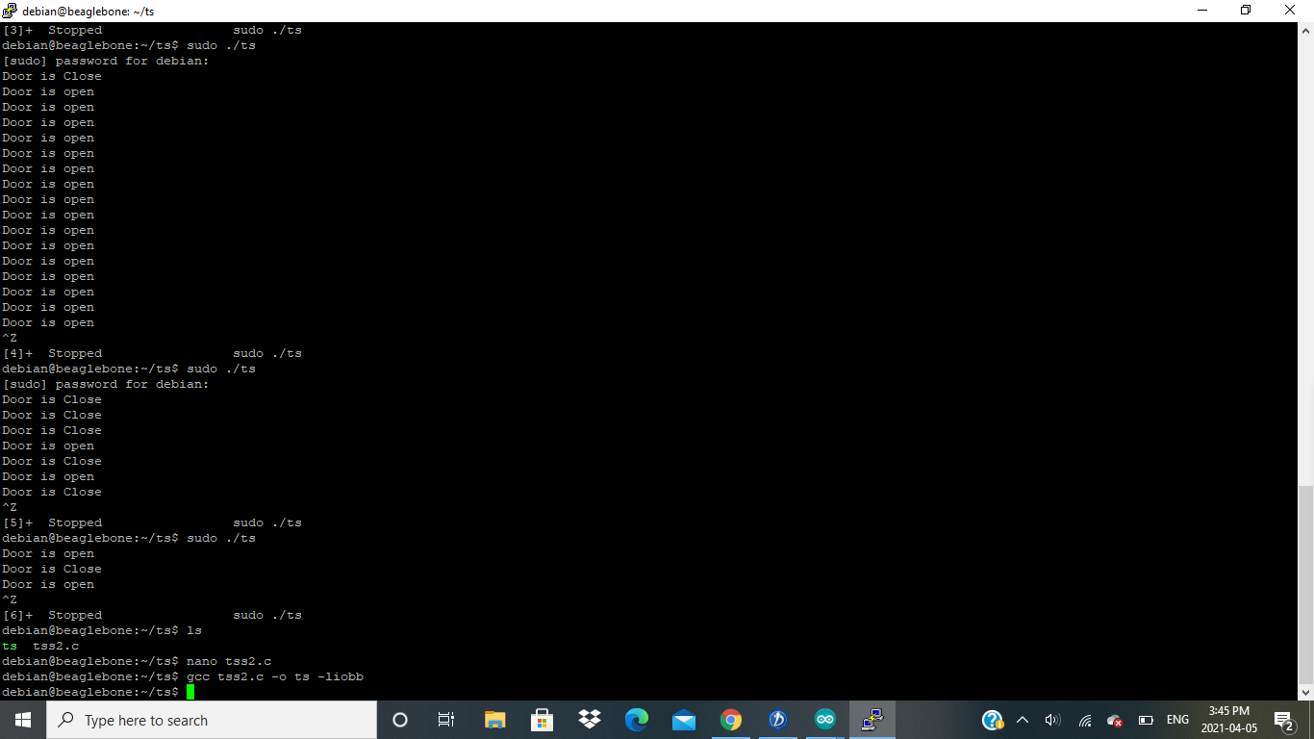
Program: Nano editor - BBB

Slide 41
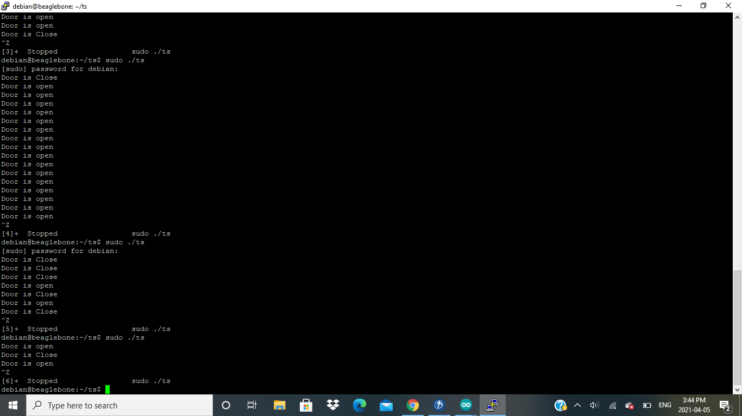
Output: Nano editor - BBB

Slide 42
Reference:
Retrieved from Components101.com, L298N Motor Driver(2020, April 13).URL:https://components101.com/modules/l293n-motor-driver-module
Retrieved from ThingSpeak https://thingspeak.com/
Retrieved from Code Project https://www.codeproject.com/Articles/845538/An-Introduction-to-ThingSpeak
MDN Web Docs https://developer.mozilla.org/en-US/docs/Web/HTTP/Overview
Webopedia https://www.webopedia.com/definitions/802-11/

Slide 43
Reference:
Retrieved from Webopedia https://www.webopedia.com/definitions/802-11/
Retrieved from MQTT https://mqtt.org/
Beaglebone.org (2019,September 6). Retrieved from https://beagleboard.org/black
Shabaz (2019,August 14) Element14.com Retrieved from https://www.element14.com/community/community/designcenter/single-board-computers/next-genbeaglebone/blog/2019/08/15/beaglebone-black-bbb-io-gpio-spi-and-i2c-library-for-c-2019-edition
ESP32 coding retrieved from randomnerdtutorial.com; URL: https://randomnerdtutorials.com/esp32-web-server-arduino-ide/

Slide 44
Reference:
Retrieved from IoT Design Pro https://iotdesignpro.com/projects/how-to-send-data-to-thingspeak-cloud-using-esp32
Retrieved from ThingSpeak https://thingspeak.com/channels/1320865

Slide 45
Thank You

